Slide 1


BOOTCAMP TRAINING – IDA
WEEK 4 REPORT
- Eeshita Deepta

Slide 2
Day 1 – Azure Data Types
Followings were the learning of Days- 1:
Azure Storage
Azure Storage Data Services
Azure Storage Accounts
Blob Storage
Azure Data Lake Storage Gen 2
Containers, Files, Tables and Queues
Data Security

Slide 3
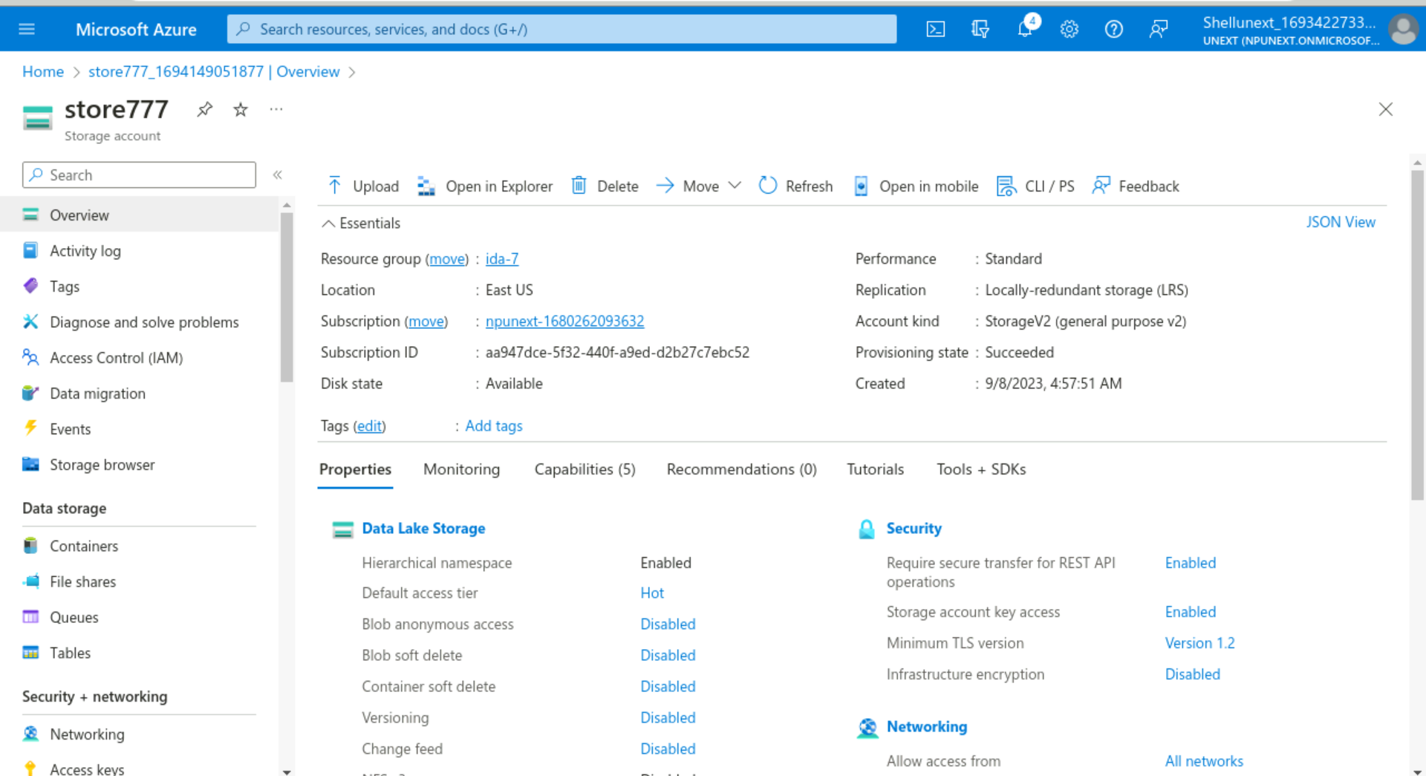

Slide 4
Day – 2 Azure Storage Types and Data Factory
Followings were the learning of Day-2:
Access and Authentication
Azure File Storage
Introduction to Azure Data Factory
ELT vs ETL
Pipelines
Integration run time
Parameters

Slide 5
Day 3 – Azure Data Factory
Followings were the learning of Day-3:
Understand ADF components
Copy Data Flow in ADF
Get Metadata Activity
If Activity
Append Activity
ForEach Loop
Input Datasets
Output Datasets

Slide 6
Day – 4 Azure Data Factory
Followings were the learning of Day-4:
Data Flow
Source Transformation
Sink Transformation
Surrogate Key
Conditional Split
Derived Column
API based transformation
Assessment

Slide 7
Day – 5 Azure Data Factory
Followings were the learning of Day-5:
Change Data Capture
CDC Implementation and Architecture
Real-time data synchronization using CDC
Mapping data flow using debug mode
CDC for real-time data propagation and synchronization

Slide 8
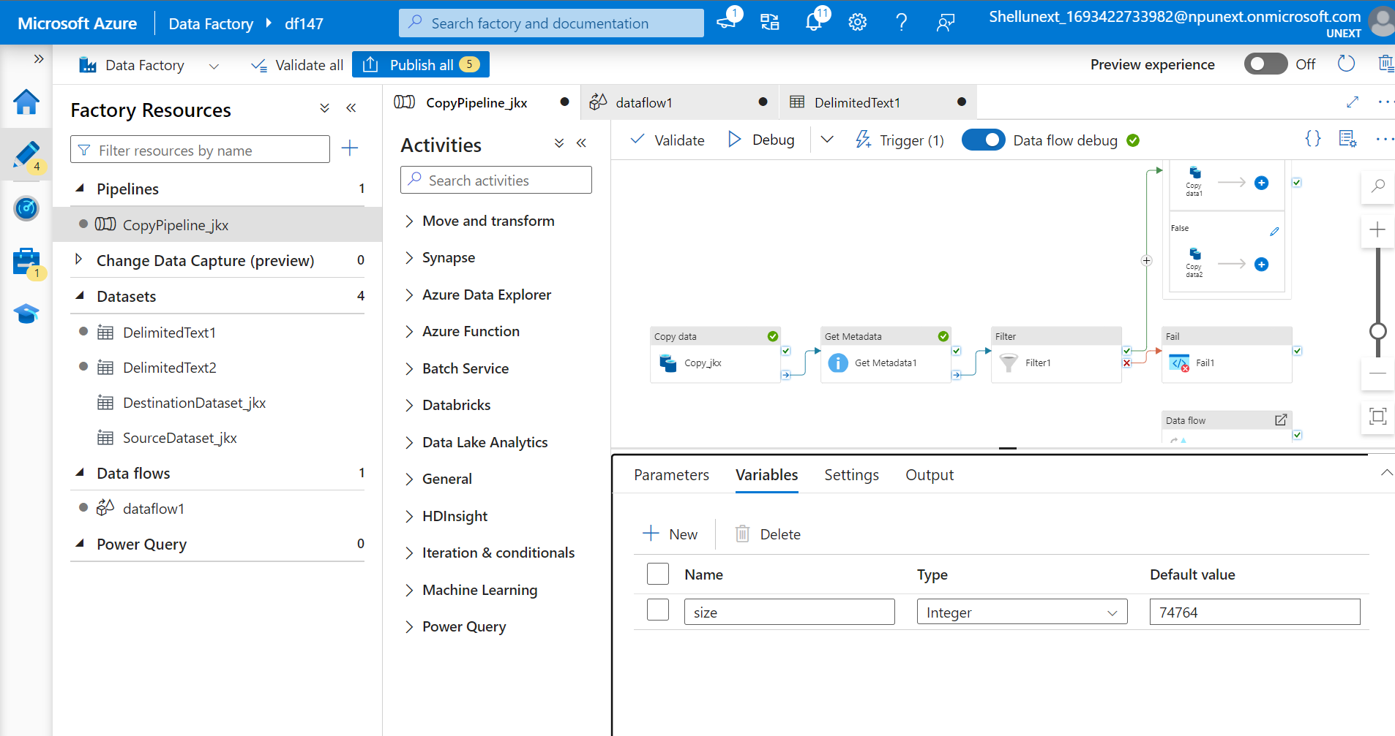

Slide 9
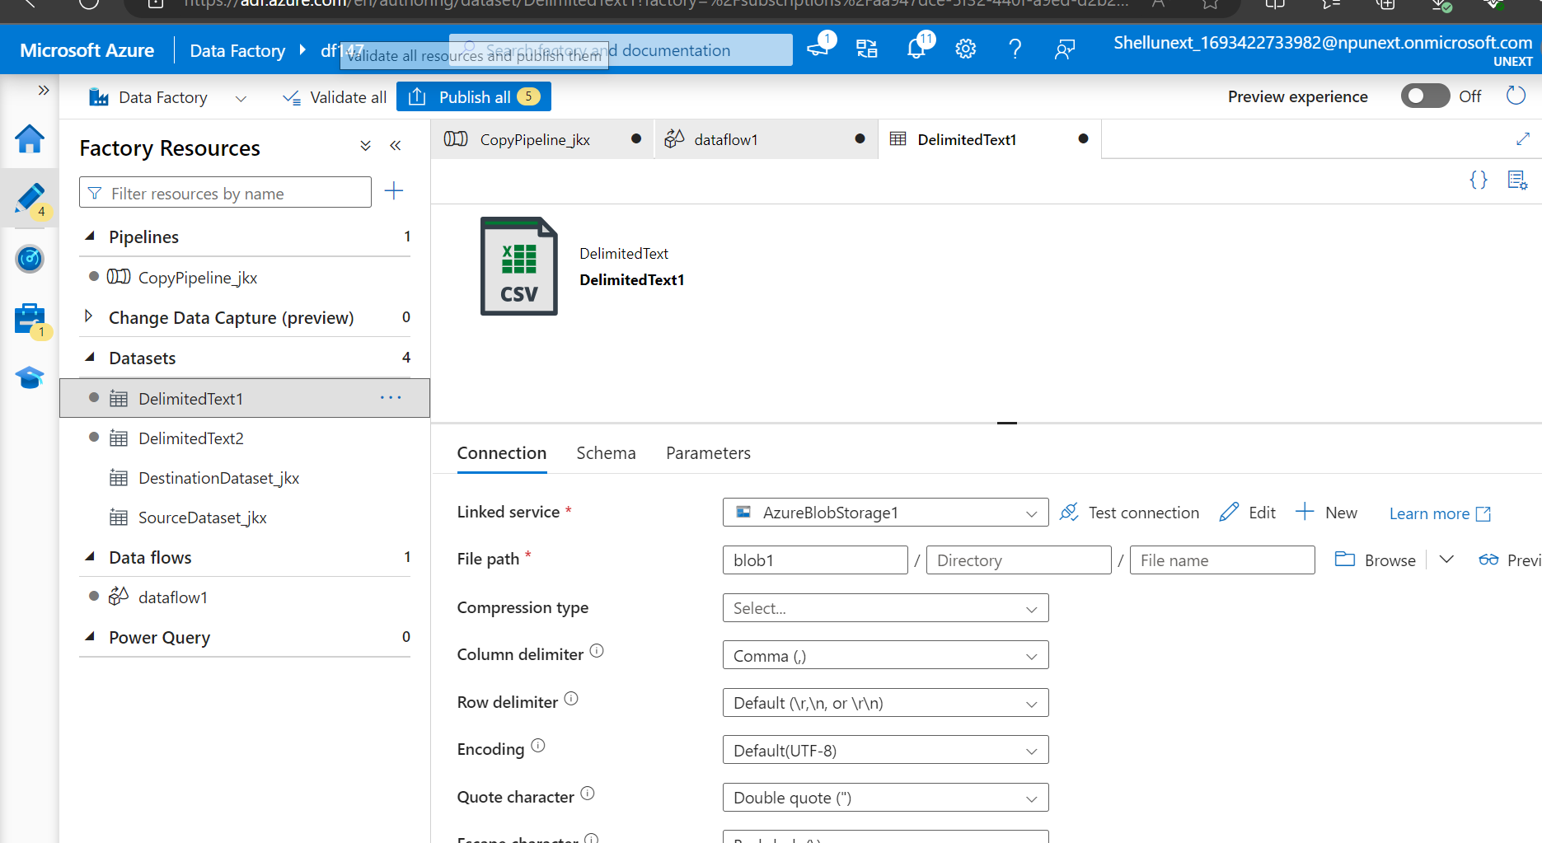

Slide 10
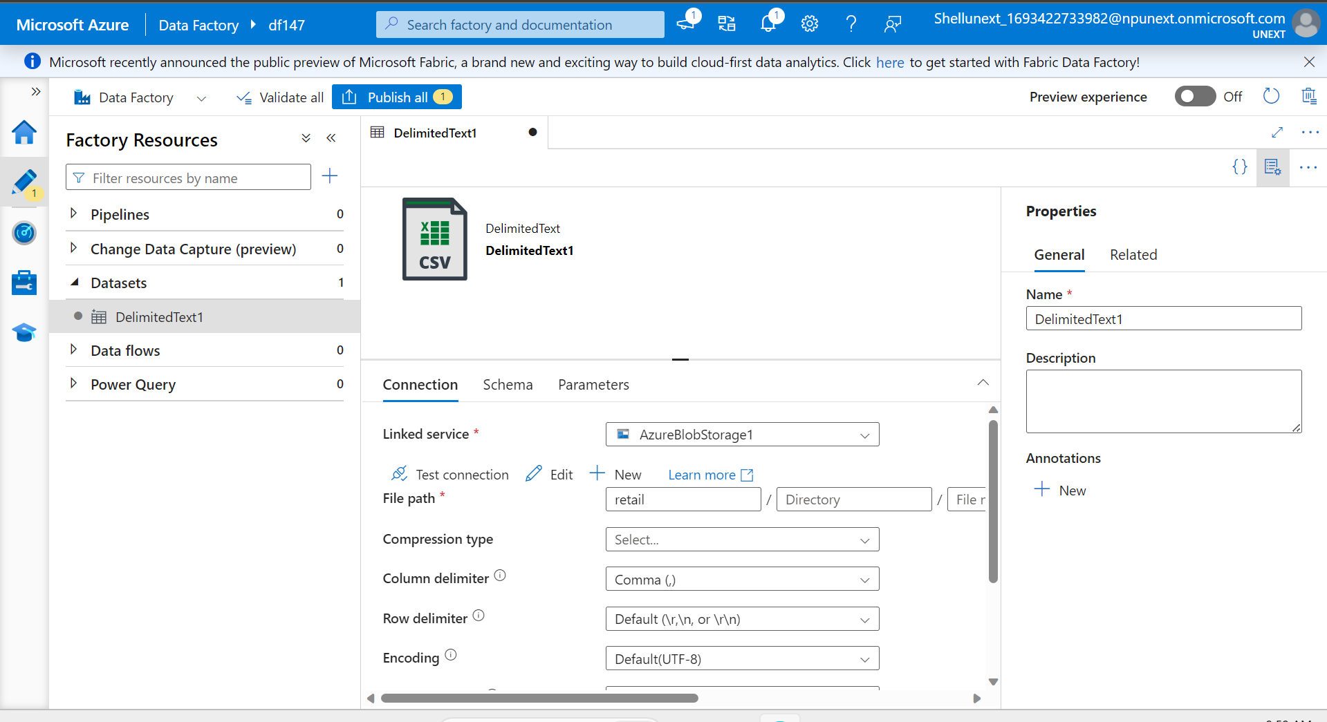

Slide 11
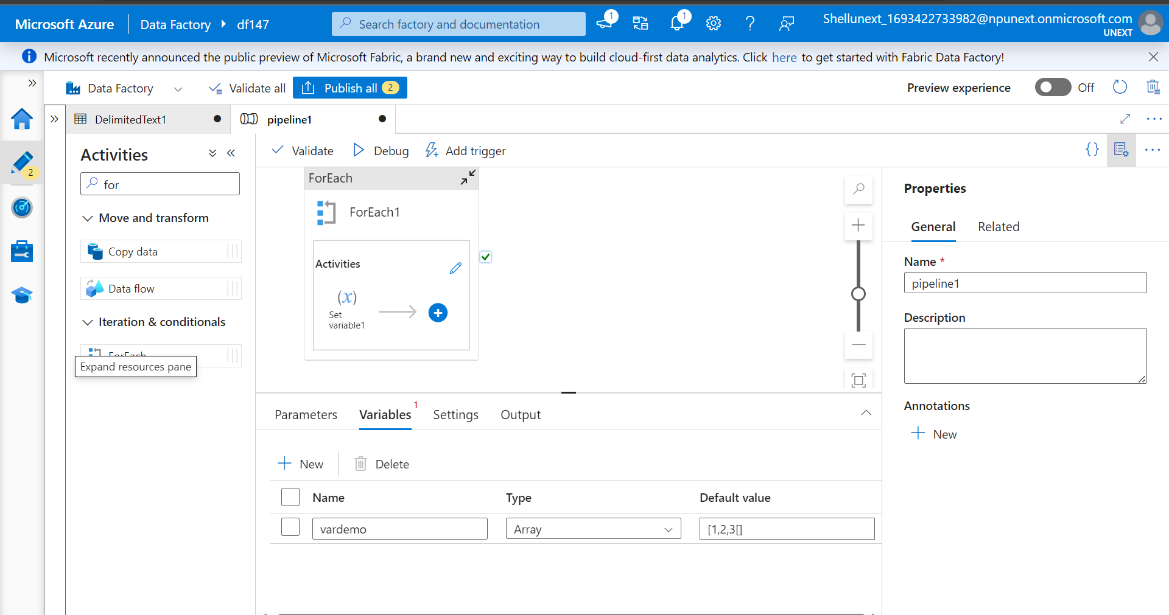

Slide 12
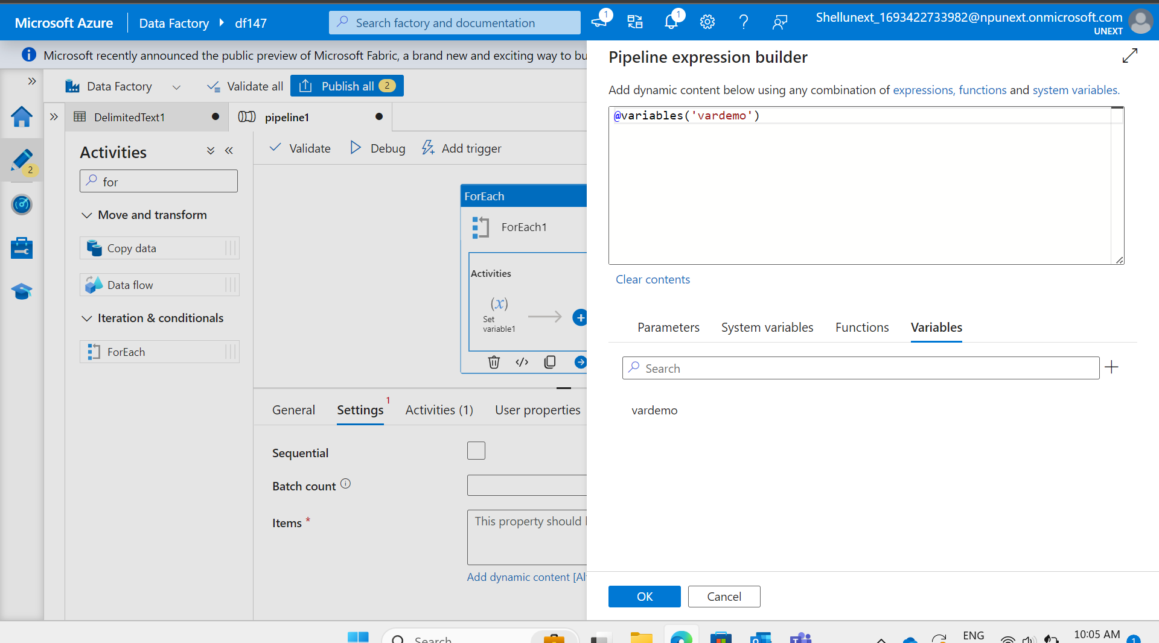

Slide 13
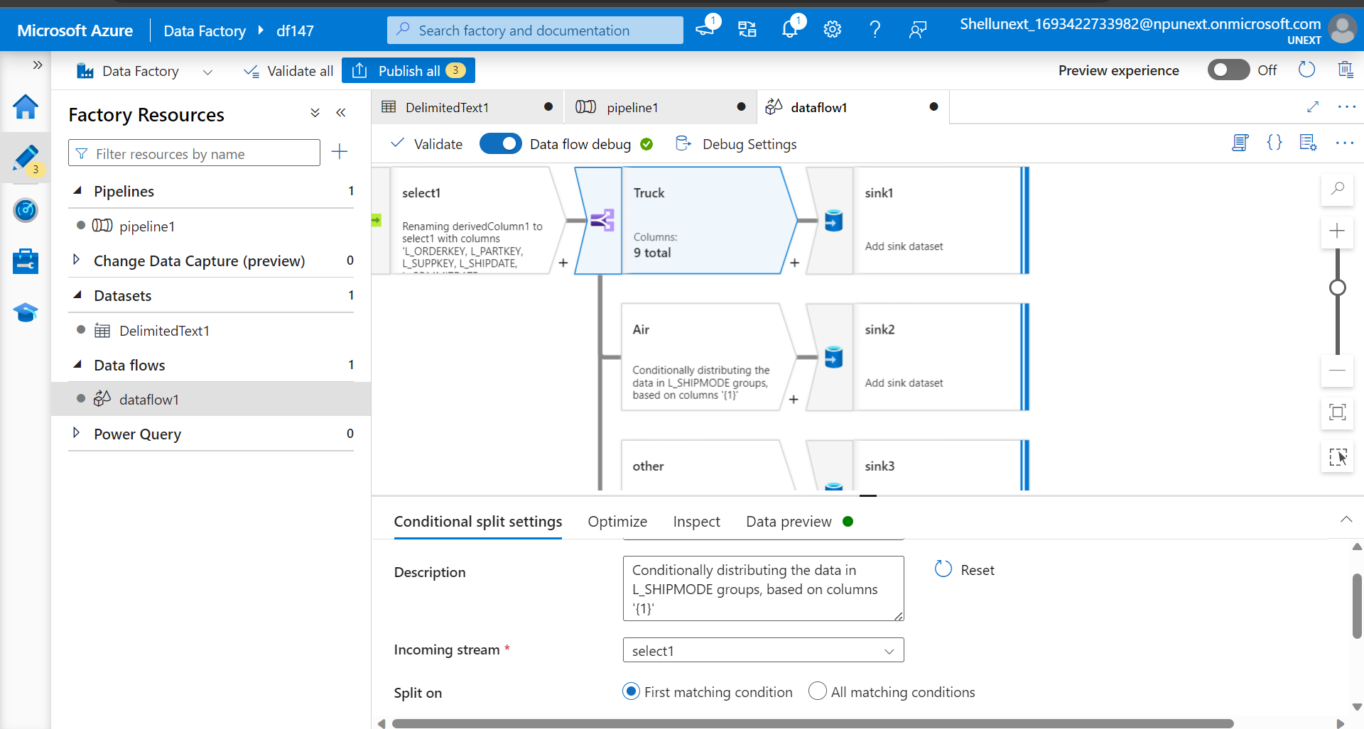

Slide 14
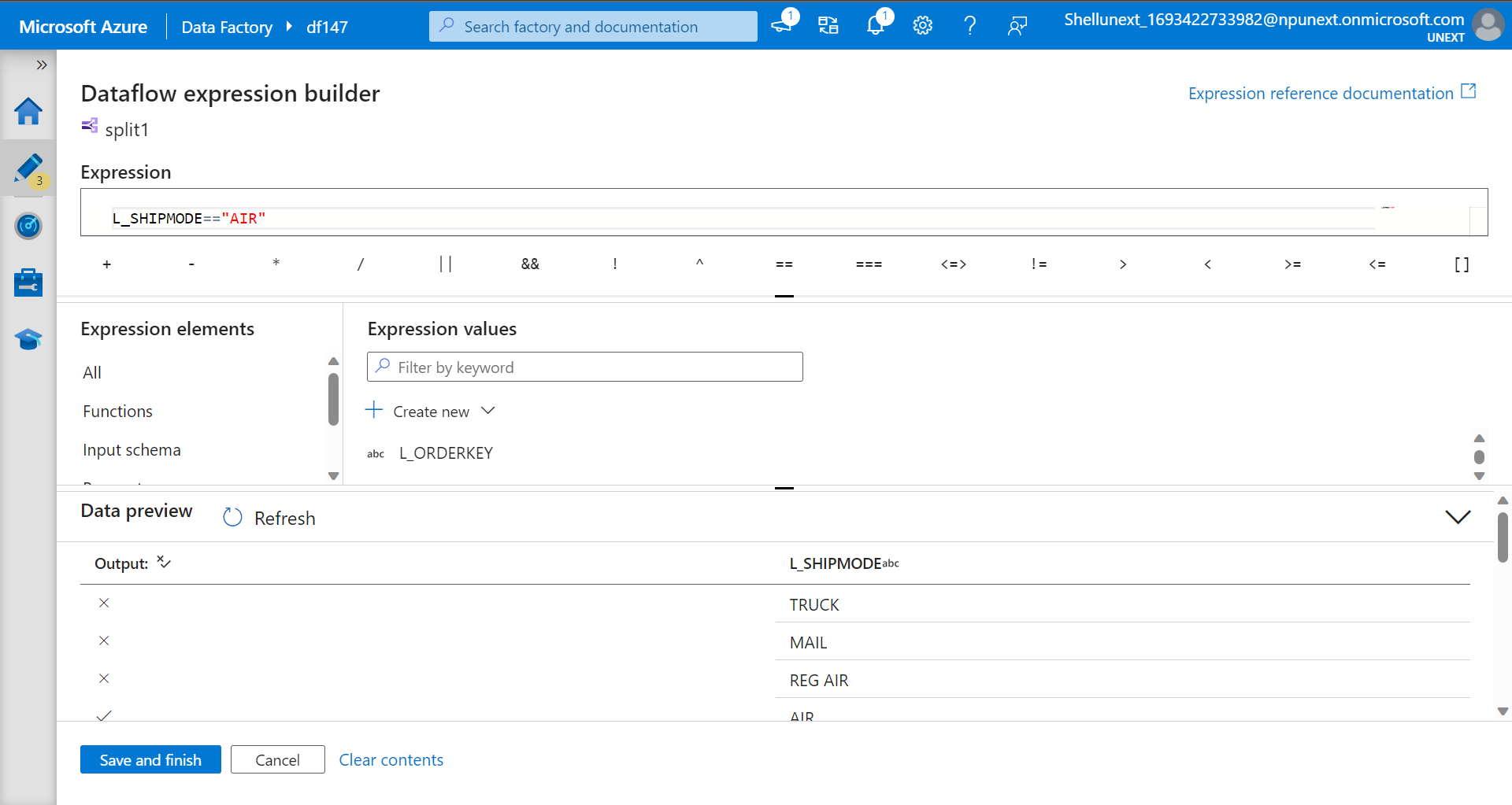

Slide 15
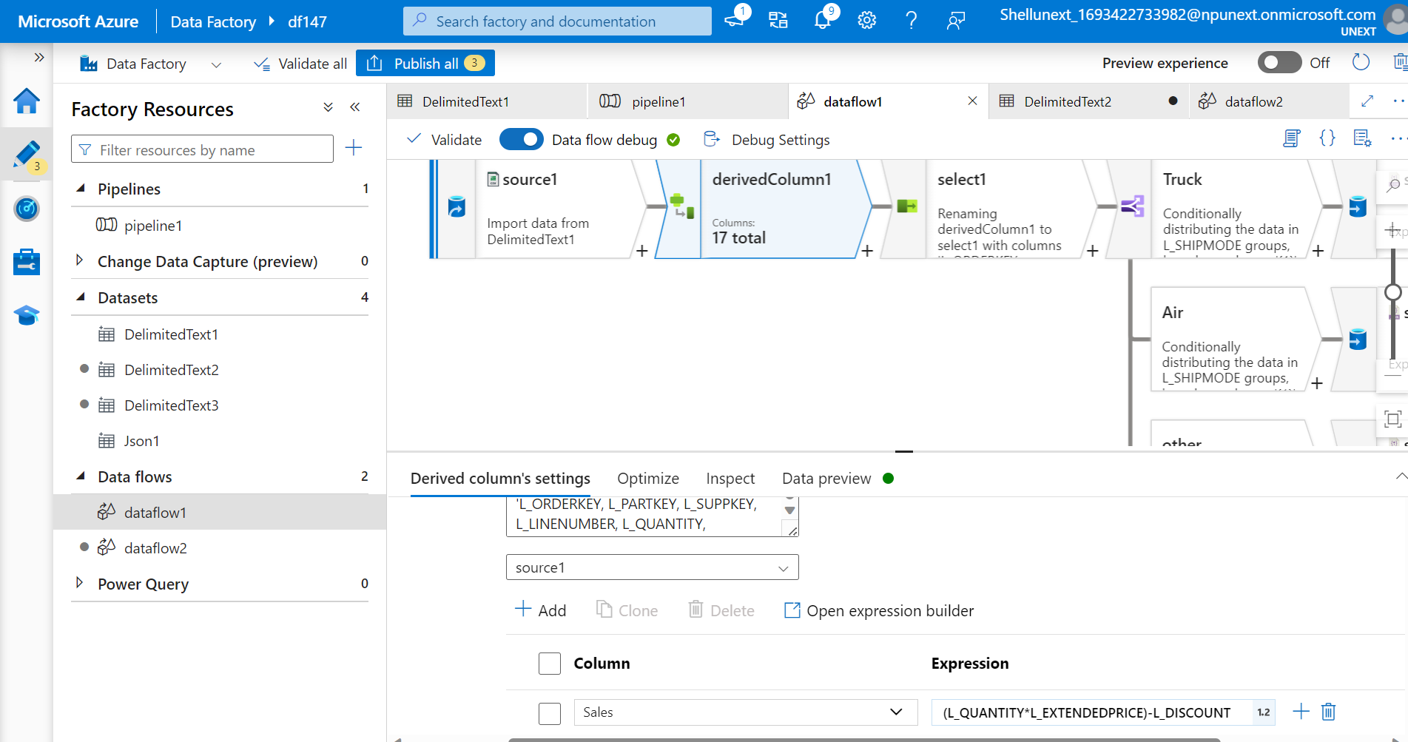

Slide 16
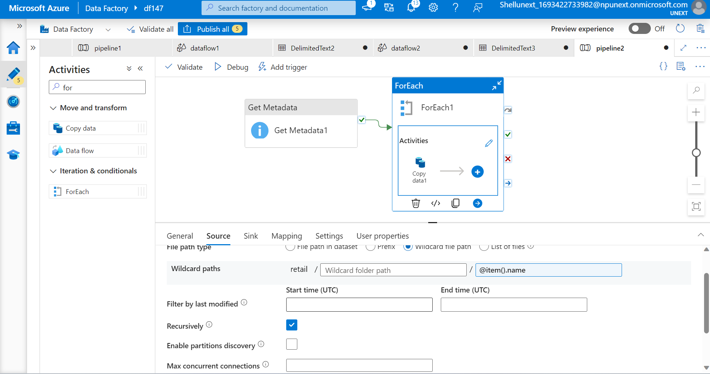

Slide 17
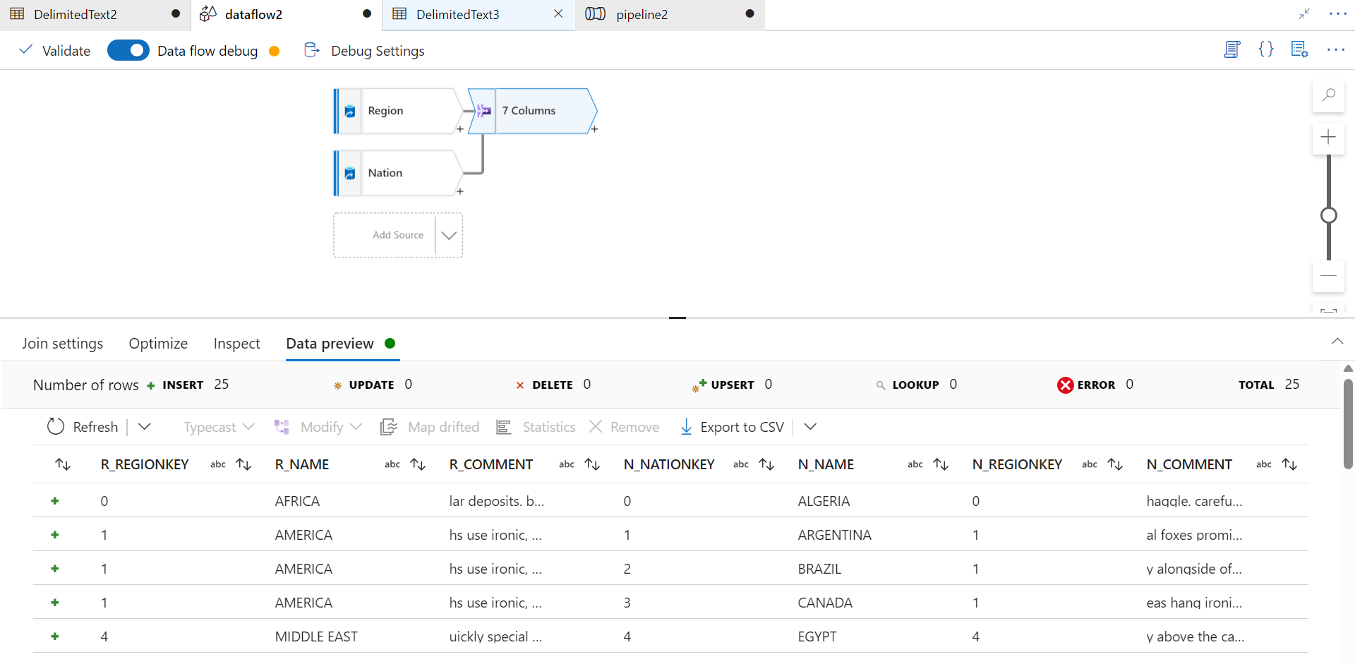

Slide 18
